Slide 1
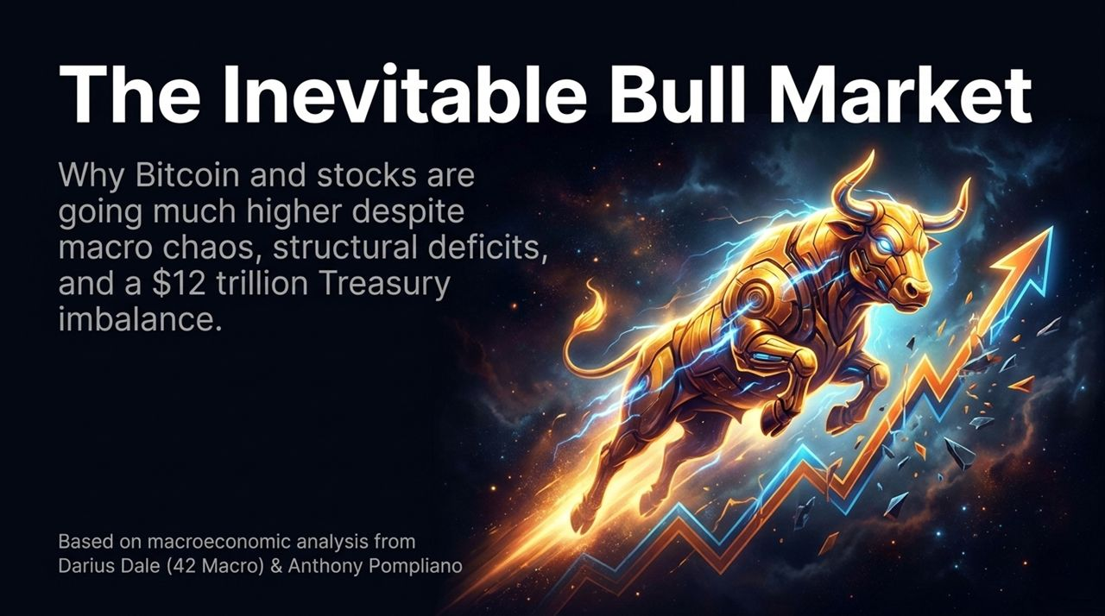
Notes:
Opening & Hook:
Welcome, everyone. Today, we are opening the doors to the Macro War Room to address what seems to be the single biggest contradiction in modern global finance: Why are risk assets—specifically Bitcoin and equities—reaching record all-time highs when the macroeconomic backdrop appears to be a total minefield?
The Core Paradox:
If you were to look at traditional macroeconomic playbooks in isolation, today's conditions would tell you to run for cover. We are staring down structural fiscal deficits, persistent geopolitical conflicts, elevated yields, and a Treasury market forced to absorb an unheard-of $12 trillion refinancing imbalance over the next 12 months. Yet, the market continues to charge upward.
Framing the Discussion:
In this presentation, drawing directly from the framework articulated by Darius Dale of 42 Macro and Anthony Pompliano, we are going to dismantle the consensus view. We will explain why this market isn't rising in spite of these macro crises—it is rising because of them. The structural mechanics of modern fiscal dominance, monetary debasement, and technological expansion have rendered a prolonged asset crash nearly impossible under current policy rules. Let’s dive in.
WARNING: Bitcoin & Stocks Are Going MUCH Higher
https://www.youtube.com/watch?v=Z7xDFOs76uY

Slide 2
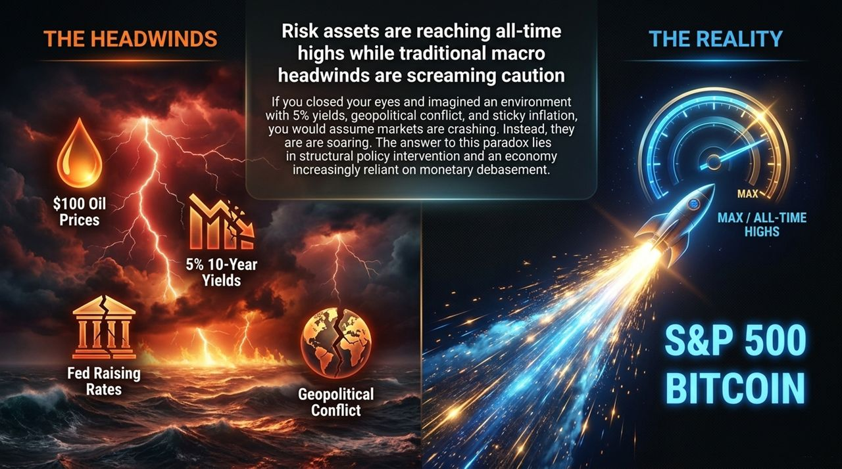
Notes:
The Thought Exercise:
To understand why investors are making money while headline readers are panicking, let's run a simple thought exercise posed by Anthony Pompliano. Imagine I put you in a room and gave you the following dataset: Oil prices hovering near $100 a barrel, 10-year Treasury yields pushing 5%, central banks raising or maintaining restrictive interest rates, widespread geopolitical fragmentation, and sticky inflation.
Conventional Wisdom vs. Market Reality:
Under any 20th-century economic model, you would bet everything that equity markets are down 30% and crypto is in a deep winter. But look at the right side of the screen: S&P 500 and Bitcoin are pushing MAX / All-Time Highs.
The Underlying Explanation:
How do we rectify these two realities? Investors haven't gone crazy, nor are they simply ignoring the risks. The market has correctly deduced that traditional macro headwinds trigger structural policy interventions. When sovereign bond markets strain under 5% yields or energy prices spike, policymakers cannot afford to let the system liquidate. They step in with dovish liquidity, bank regulatory relief, and monetary easing. The 'headwinds' actively force the liquidity injections that fuel risk assets.

Slide 3
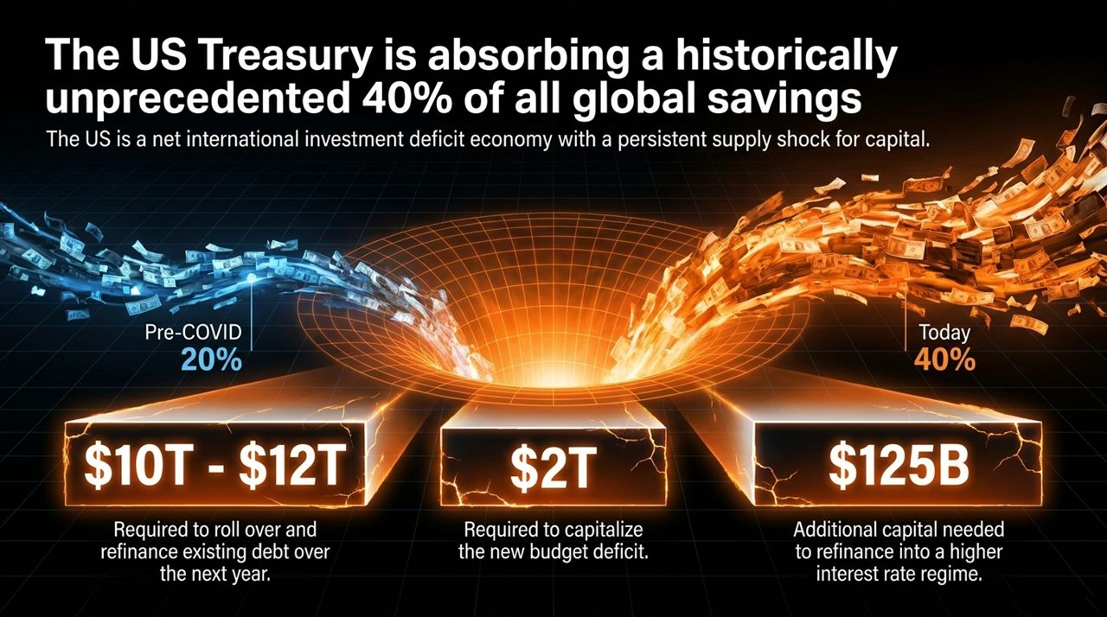
Notes:
The Math Behind Fiscal Dominance:
Let's look at the raw mathematical reality facing the US Treasury. Darius Dale points out that the fundamental 'PC1'—the primary principal component of global finance today—is that US Treasury bonds are losing their status as a risk-free safe haven. Why? Because the US Treasury’s appetite for global capital has doubled.
The 20% to 40% Global Savings Drain:
Prior to COVID-19, the US Treasury required roughly 20% of global net savings flows annually to fund itself. Today, that number has surged to 40% of all global savings. The US is a net international investment deficit economy with a 3% to 4% annual current account deficit. It must attract trillions in foreign and domestic capital every year just to keep the status quo.
Breaking Down the Numbers:
Look at the requirements over the next 12 months alone:
$10 Trillion to $12 Trillion needed just to roll over and refinance existing maturing national debt.
$2 Trillion in net new capital required to fund the ongoing federal budget deficit.
$125 Billion in additional net interest expense due to refinancing into a higher yield regime.
The Squeezing Dynamic:
When the sovereign government takes 40% of all global savings, it starves the rest of the economy. It drains capital from mortgage markets, small business lending, and lower-income consumers. This persistent supply shock for capital creates an unsustainable imbalance that forces government action.

Slide 4
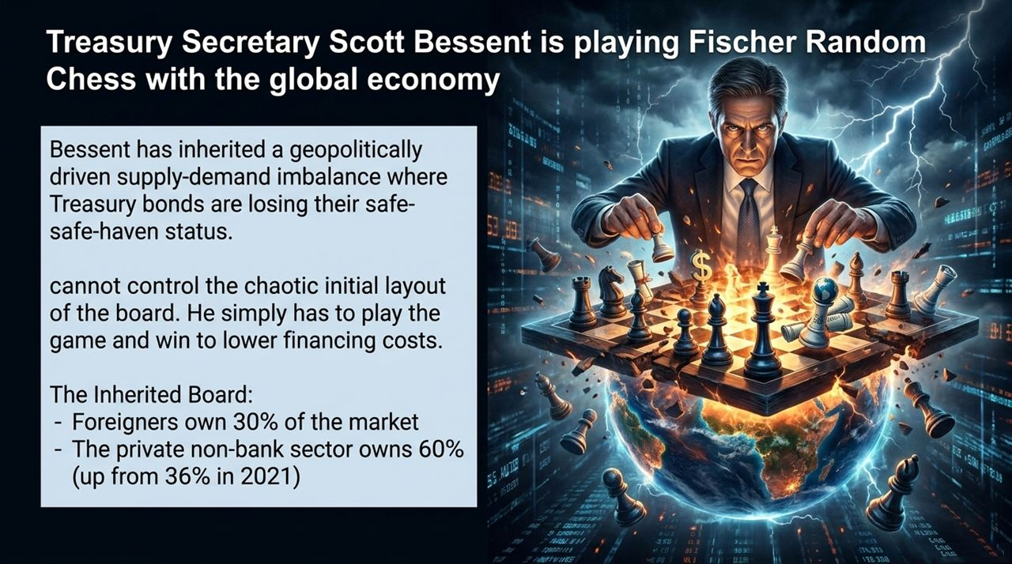
Notes:
The Analogy:
When Treasury Secretary Scott Bessent took the helm, he didn't inherit a standard, orderly chess board. He inherited what Pomp and Darius describe as Fischer Random Chess—a game where the pieces are shuffled randomly at the start. You don't get to choose where your pieces start; you simply have to play the board in front of you and win by driving down federal financing costs.
The Board Layout (Changing Ownership Structure):
What does the board look like?
Foreign Central Banks & Investors now hold only ~30% of US Treasury debt, down significantly from historical norms as geopolitical fragmentation takes hold.
The Private Non-Bank Sector (hedge funds, money market funds, households) has been forced to absorb the difference, rising from 36% in late 2021 to over 60% today.
The Consequence of the Board:
Because the buyer base has shifted from price-insensitive official institutions (like foreign central banks) to price-sensitive private investors, every new unit of Treasury issuance demands higher yield compensation. Bessent understands this structural flaw. A lesser operator would get dragged by the market, but the current strategy is active maneuverability: testing liquidity and preparing interventions to manage yields.

Slide 5
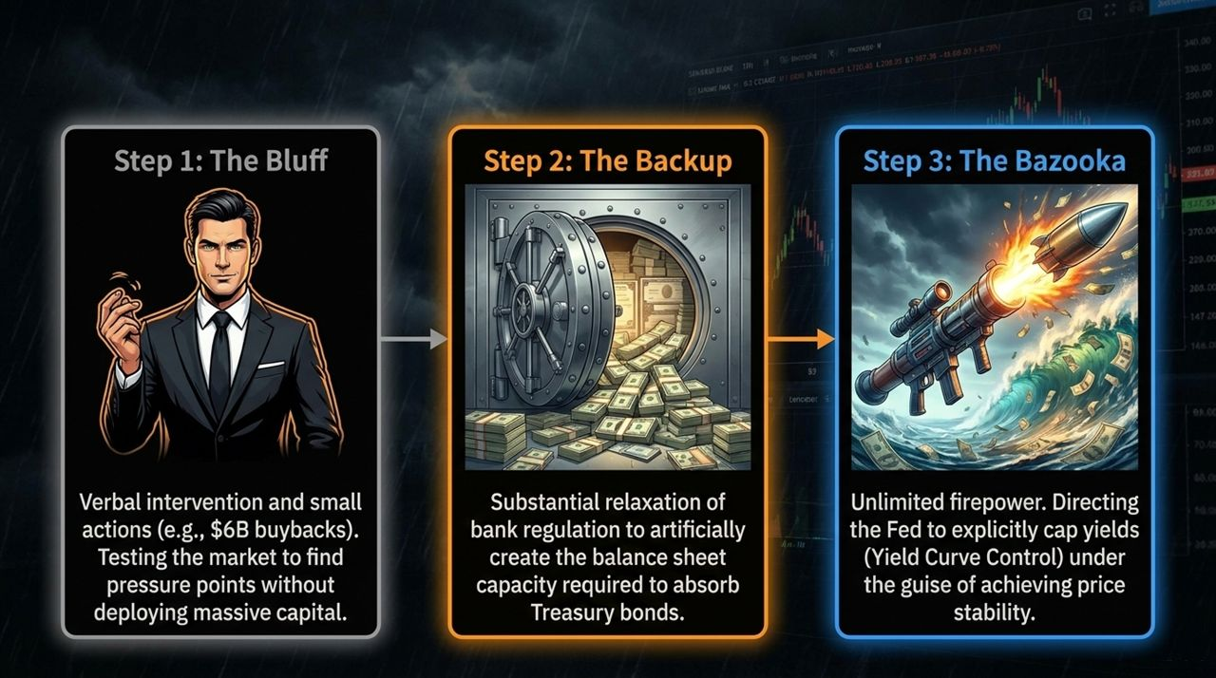
Notes:
The Three-Step Intervention Ladder:
How does the Treasury navigate a market that demands higher yields than the budget can afford? By deploying a deliberate, escalating policy playbook.
Step 1: The Bluff (Prodding the Market):
It starts with verbal intervention and minor liquidity adjustments, such as $6 billion buyback programs. As Pomp notes in the video, this is like an insurgent force testing a perimeter. You fire a few small shots to see how the market reacts, where the pressure points are, and what leverage you have without expending real capital.
Step 2: The Backup (Regulatory Liquidity):
If the market calls the bluff, the Treasury moves to Step 2: Bank Deregulation. By relaxing bank leverage constraints (like the Supplementary Leverage Ratio / SLR), policymakers artificially create balance sheet capacity within commercial banks, effectively forcing/enabling them to absorb hundreds of billions in Treasuries.
Step 3: The Bazooka (Yield Curve Control / Monetization):
If yields still spike and threaten debt sustainability, the Treasury pulls out the Bazooka: Directing the Federal Reserve to implement Yield Curve Control (YCC) or Reserve Management Purchases. Under the guise of maintaining 'price stability' or 'orderly market functioning'—the Fed's underrated third mandate—the central bank steps in with un-capped balance sheet expansion to buy Treasuries. This is pure monetary expansion, and it guarantees asset price inflation.

Slide 6
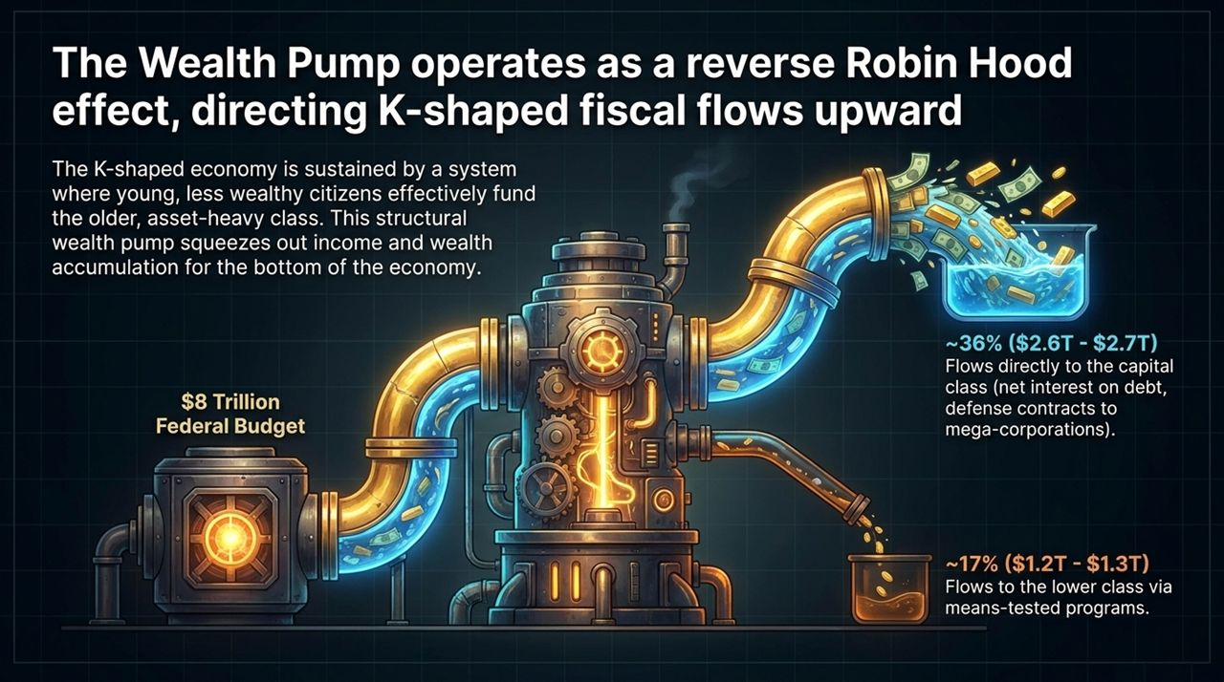
Notes:
The Reverse Robin Hood Effect:
To understand why social tension is rising while asset holders are getting rich, we look at what Darius Dale calls the Reverse Robin Hood Effect—or Peter Turchin’s academic concept of the Wealth Pump.
Dissecting the $8 Trillion Federal Budget:
If you analyze the nearly $8 trillion federal budget, the flow of capital is structurally skewed:
~36% ($2.6 Trillion to $2.7 Trillion) flows directly into the pockets of the capital class. This occurs via net interest payments on national debt (over $1.1T on its way to $1.2T) and massive defense/tech spending flowing to mega-corporations. Lower-income citizens do not hold Treasury bonds or large stock portfolios, so they receive zero interest income.
Only ~17% ($1.2 Trillion to $1.3 Trillion) flows to lower-income citizens via means-tested welfare programs.
Young vs. Old Dynamics:
At the same time, systems like Social Security operate as a demographically challenged transfer mechanism where younger, less wealthy W2 laborers directly fund older, asset-rich generations. The system continuously extracts income from labor and pumps it directly into asset yields.

Slide 7
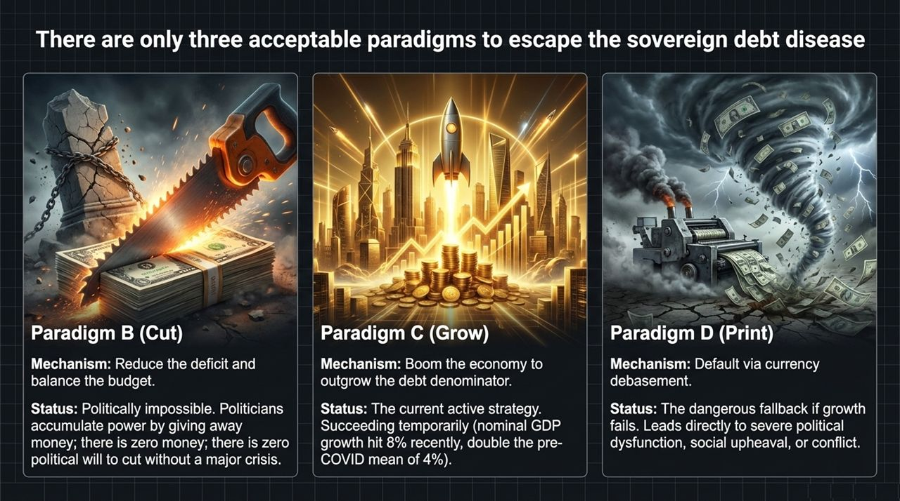
Notes:
The Three Acceptable Paradigms:
Macroeconomically, there are only three ways a sovereign nation can escape a severe debt burden. Let's break down why only one path is actively being pursued.
Paradigm B: Cut (Deficit Reduction):
Mechanism: Reduce spending, balance the budget, and pay down the debt.
Status: Politically Impossible. As Anthony Pompliano candidly reflected, politicians accumulate power by giving away money to their constituents. Whether it’s DOGE initiatives or austerity promises, the political will to slash trillions from the budget does not exist without a catastrophic, active crash.
Paradigm C: Grow (Outrunning the Debt):
Mechanism: Expand the nominal economy so fast that nominal GDP growth outpaces the growth of debt.
Status: The Active Strategy. Policymakers are attempting to run the economy hot. Non-government, net-export nominal GDP growth recently hit 8%—double the pre-COVID baseline of 4%. This is the primary objective.
Paradigm D: Print (Currency Debasement):
Mechanism: Default on debt via stealth inflation and currency devaluation.
Status: The Unavoidable Fallback. If growth stalls, the central bank must monetize deficits to prevent sovereign default. This is the most inflationary path and triggers massive societal friction.

Slide 8
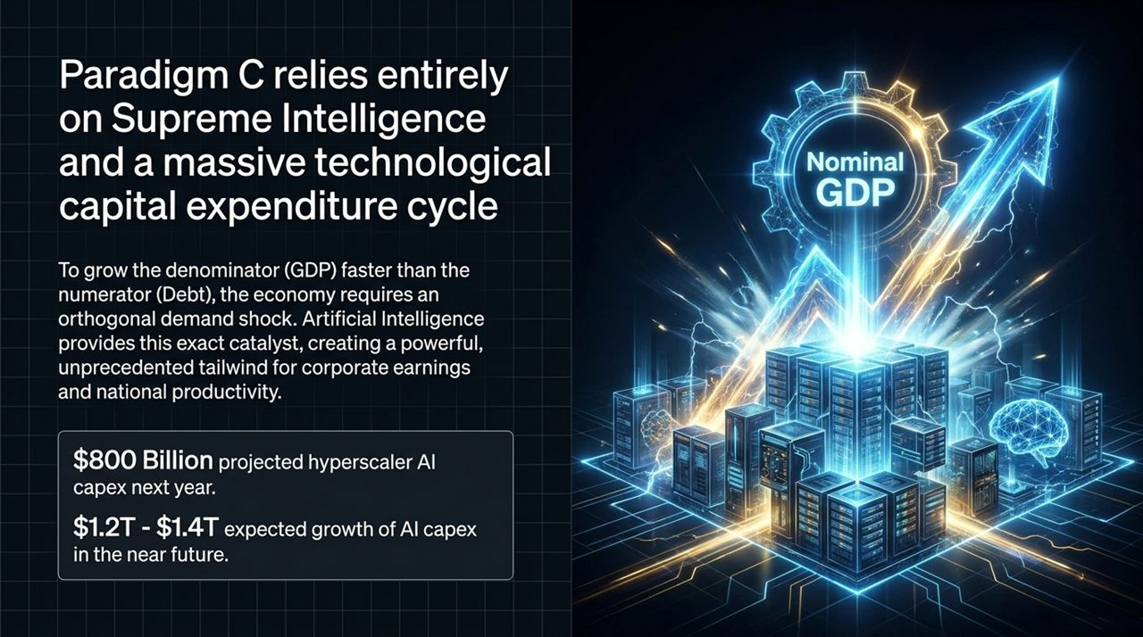
Notes:
The Demand Shock Requirement:
To make Paradigm C (Grow) work, you cannot rely on traditional labor or linear productivity gains. You need an orthogonal demand shock—a technological leap that shifts the productivity curve outward.
AI Capex as the Growth Engine:
Enter Artificial Intelligence—or as Darius Dale humorously terms it, 'Supreme Intelligence'. Look at the corporate expenditure projections:
$800 Billion in hyper-scaler AI capital expenditure projected for next year alone.
$1.2 Trillion to $1.4 Trillion in near-future annual AI capex scaling.
The Mathematical Impact on Equities:
This massive, unprecedented capex cycle generates an immense tailwind for corporate earnings. Even if broader economic sectors feel strained, the sheer volume of capital flowing into tech, energy infrastructure, and semiconductors drives S&P 500 profit margins upward, providing structural fundamental support for equity prices.

Slide 9
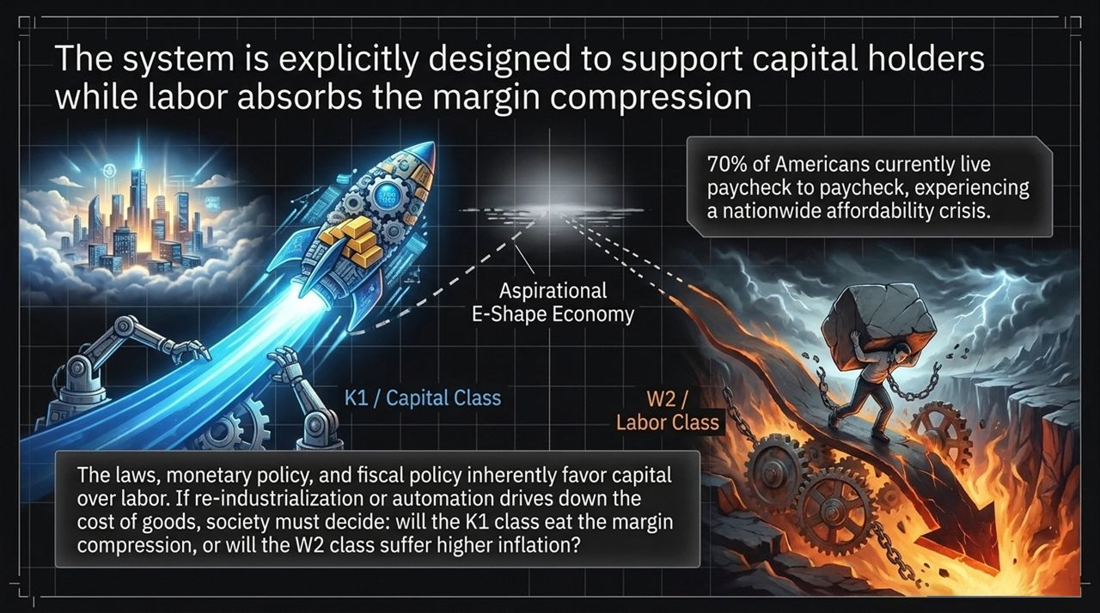
Notes:
The Paycheck-to-Paycheck Crisis:
While asset prices soar, the real-world condition of the average worker is alarming. Senior banking data shows that 70% of American households live paycheck to paycheck. The bottom half of the K-shaped economy is suffering a severe, prolonged affordability crisis.
Capital Favored Over Labor:
Our legal, monetary, and fiscal architecture is explicitly structured to protect and inflate capital over labor. W2 wage earners are fully exposed to cost-of-living inflation, whereas K1 asset owners receive compound growth from real estate, equities, and business cash flows.
The Re-Industrialization Dilemma:
As the US attempts to re-industrialize and automate, society faces a stark choice: When production costs fluctuate, who absorbs the margin compression? Will corporate capital holders swallow lower profit margins, or will W2 labor absorb it through higher consumer prices and real-wage decay? Historically, policy ensures labor takes the brunt of the adjustment.

Slide 10
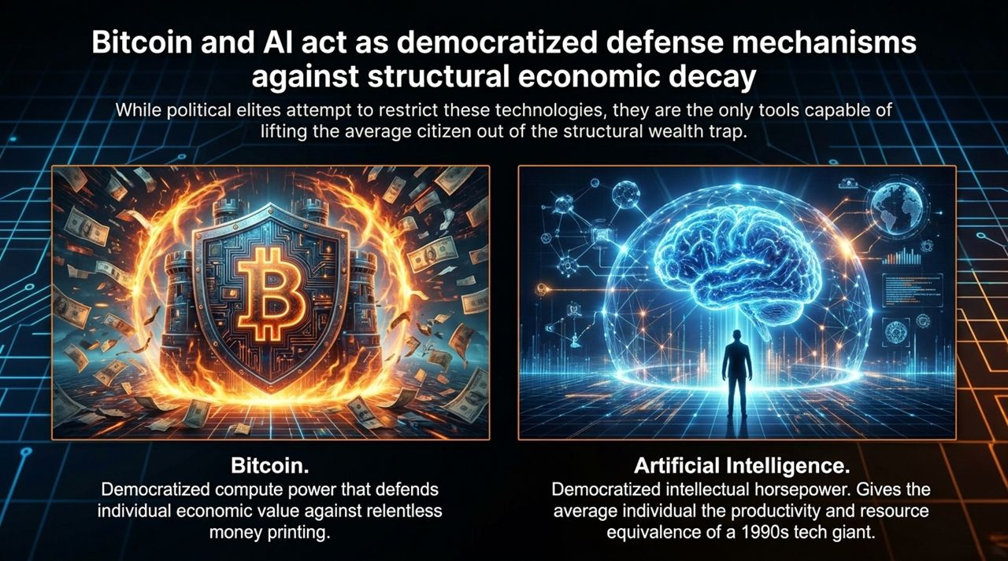
Notes:
Tools for Economic Survival:
In an environment defined by structural monetary debasement and a biased wealth pump, how does an individual protect their purchasing power? Pomp and Darius highlight two revolutionary technologies acting as democratized defense mechanisms.
Bitcoin (Democratized Asset Defense):
Bitcoin represents an army of global compute dedicated to defending individual economic value against relentless fiat debasement. It takes the sovereign protection mechanisms once reserved for global elites and democratizes them into an un-censorable, fixed-supply hard asset accessible to anyone with a smartphone.
AI (Democratized Productivity):
AI provides democratized intellectual firepower. Thirty years ago, running a high-output enterprise required the capital and human resource scale of a Bill Gates. Today, generative AI tools provide an average individual with the productivity and analytical horsepower equivalent to an entire 1990s corporate team.
The Synthesis:
While political forces often attempt to regulate or restrict these tools, Bitcoin and AI represent the primary self-defense mechanisms for individuals looking to escape the W2 labor trap and build lasting equity.

Slide 11
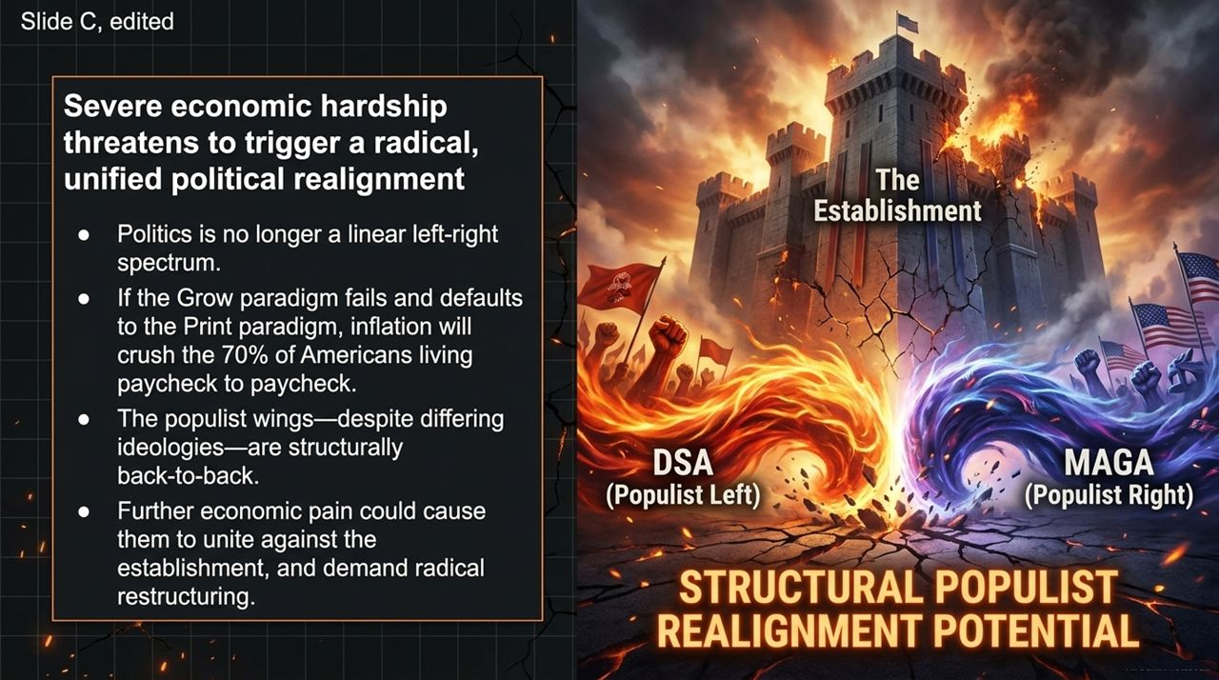
Notes:
Rethinking the Political Spectrum:
The conventional linear Left-versus-Right political model is broken. Darius Dale presents a far more accurate conceptualization: Politics is a 360-degree circle.
The Back-to-Back Populists:
On this circular field, the Populist Right (MAGA) and the Populist Left (DSA) are not opposite poles—they are structurally positioned back-to-back, separated only by cultural rhetoric. Both factions are driven by the exact same root frustration: a system that extracts their wealth to fund the financial establishment.
The Paradigm D Trigger:
If policy slips from Paradigm C (Grow) into Paradigm D (Print/Debasement), inflation will devastate the 70% living paycheck to paycheck. When real economic survival is threatened, cultural differences fade. The two populist wings risk turning around, uniting against the establishment, and demanding a radical, destabilizing restructuring of the financial and political system.

Slide 12
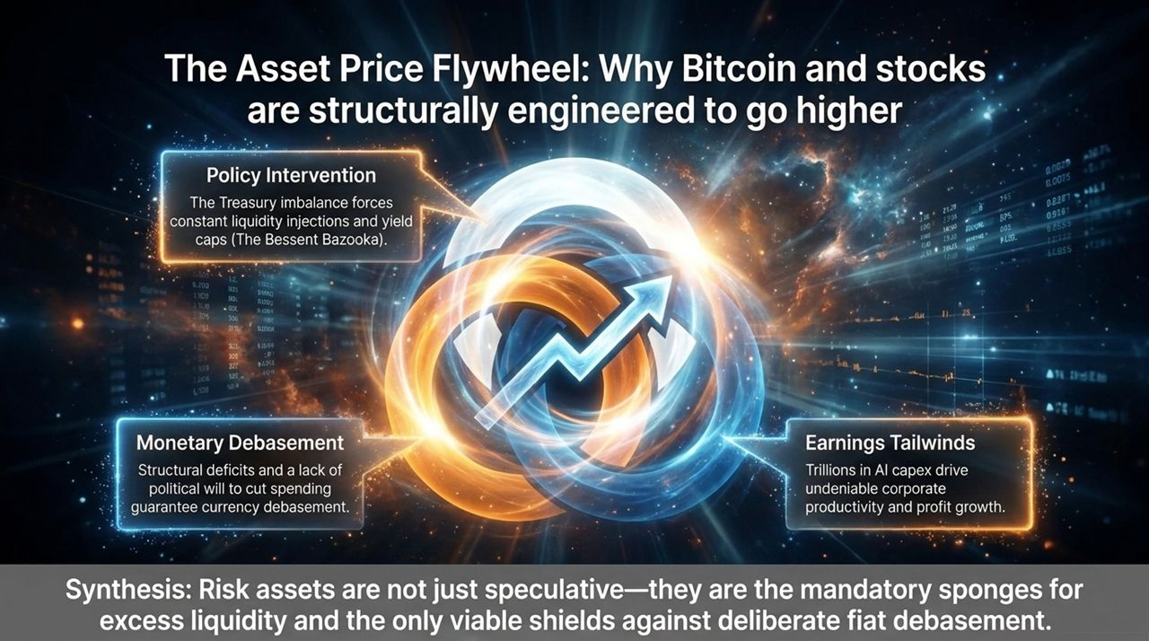
Notes:
Connecting the Engine Components:
Now let’s bring all these macroeconomic forces together into a self-reinforcing loop: The Asset Price Flywheel.
Engine Part 1: Policy Intervention:
The $12 trillion Treasury refinancing wall forces the Treasury and Fed to deploy dovish financing policies, bank leverage tweaks, and yield caps.
Engine Part 2: Monetary Debasement:
Because politicians cannot and will not cut spending, structural deficits guarantee a expanding supply of fiat money, devaluing paper currency.
Engine Part 3: Earnings Tailwinds:
Trillions in AI capital expenditure create real, high-margin revenue for market leaders, keeping equity earnings growth strong.
The Takeaway:
Risk assets are not in an irrational bubble. Equities and Bitcoin act as mandatory liquidity sponges. They are the only viable vehicles capable of absorbing excess global liquidity and outrunning deliberate monetary debasement.

Slide 13
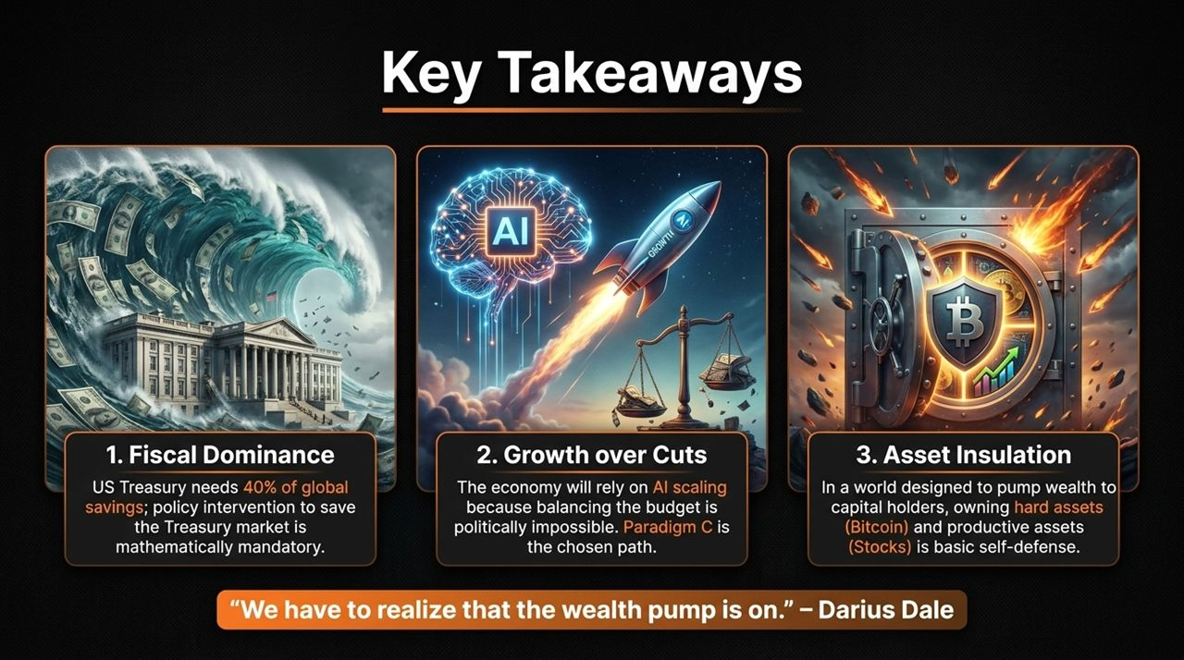
Notes:
Synthesis of the Drivers:
To recap our War Room analysis:
Dovish Treasury & Fed Intervention: Public debt stresses actively force central planners to support market liquidity.
Corporate AI Capex ($800B+): Real technological advancement provides corporate cash flow growth that validates stock valuations.
The Sovereign Debt Choice: Paradigm B (cutting) is off the table. Paradigm C (growing via tech) is the active priority. Paradigm D (printing) is the backstop.
The Structural Bull Narrative:
This dual engine—technological earnings growth on one side, and mandatory monetary easing on the other—creates the most robust environment for asset price expansion seen in modern financial history.

Slide 14

Notes:
3 Tactical Rules for Investors:
As we conclude, leave this presentation with three core rules extracted from Darius Dale and Anthony Pompliano's discussion:
Fiscal Dominance is Absolute: The US Treasury needing 40% of global savings means central bank independence is secondary to sovereign solvency. Intervention is mathematically mandatory.
Growth Over Cuts: Do not position your portfolio for government austerity. Paradigm C is the only political path; ride the AI scaling wave.
Asset Insulation is Self-Defense: In a financial system engineered to pump wealth upward to capital holders, holding cash is financial suicide. Owning scarce assets (Bitcoin) and productive assets (Stocks) is basic economic self-defense.
Closing Quote:
As Darius Dale succinctly summarized: 'We have to realize that the wealth pump is on.' Adjust your portfolio to match the board you are actually playing on.

Slide 15
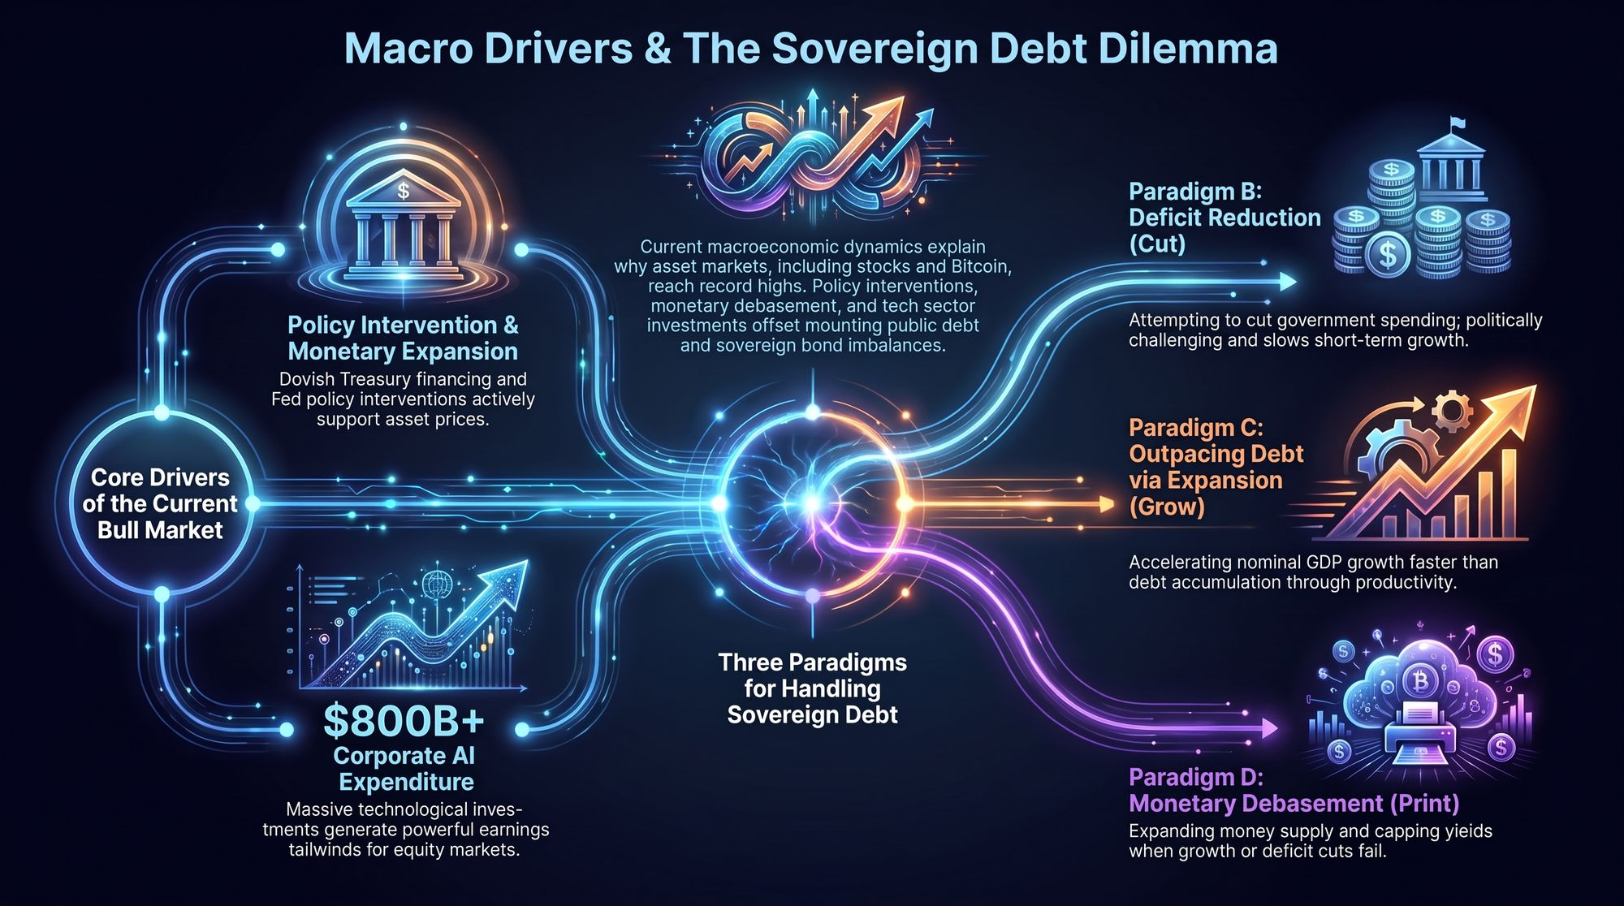
Notes:
Executing Full Cycle Risk Management:
Understanding these macro mechanics is not about blindly buying every dip or taking uncalculated risks. It is about implementing full-cycle risk management.
Navigating Bull & Bear Cycles:
As 42 Macro emphasizes, full-cycle risk management requires two things:
Staying invested long enough in bull cycles to capture maximum structural upside driven by liquidity and earnings.
Recognizing structural pivots early enough in bear cycles so you don't blow up your portfolio when policy intervention temporarily stalls.
Final Thoughts:
The bull market in hard assets and stocks is structurally supported by the math of sovereign debt and technological expansion. Position accordingly, manage your downside risk, and take control of your financial security. Thank you, and I will now open the floor for Q&A.
WARNING: Bitcoin & Stocks Are Going MUCH Higher
https://www.youtube.com/watch?v=Z7xDFOs76uY

